Slide 1
Data Science – Project 1
Final Presentation - Group I
Notes:
Michea

Slide 2
Dataset - 1
Dataset Overview:
Contains individual records of people.
Anonymous surveyes among students
~28’000 rows
Study on stress and depression level related to university pressure, lifestyle, and other factors.
What Each Row Represents:
Each row represents one person’s profile.

Slide 3
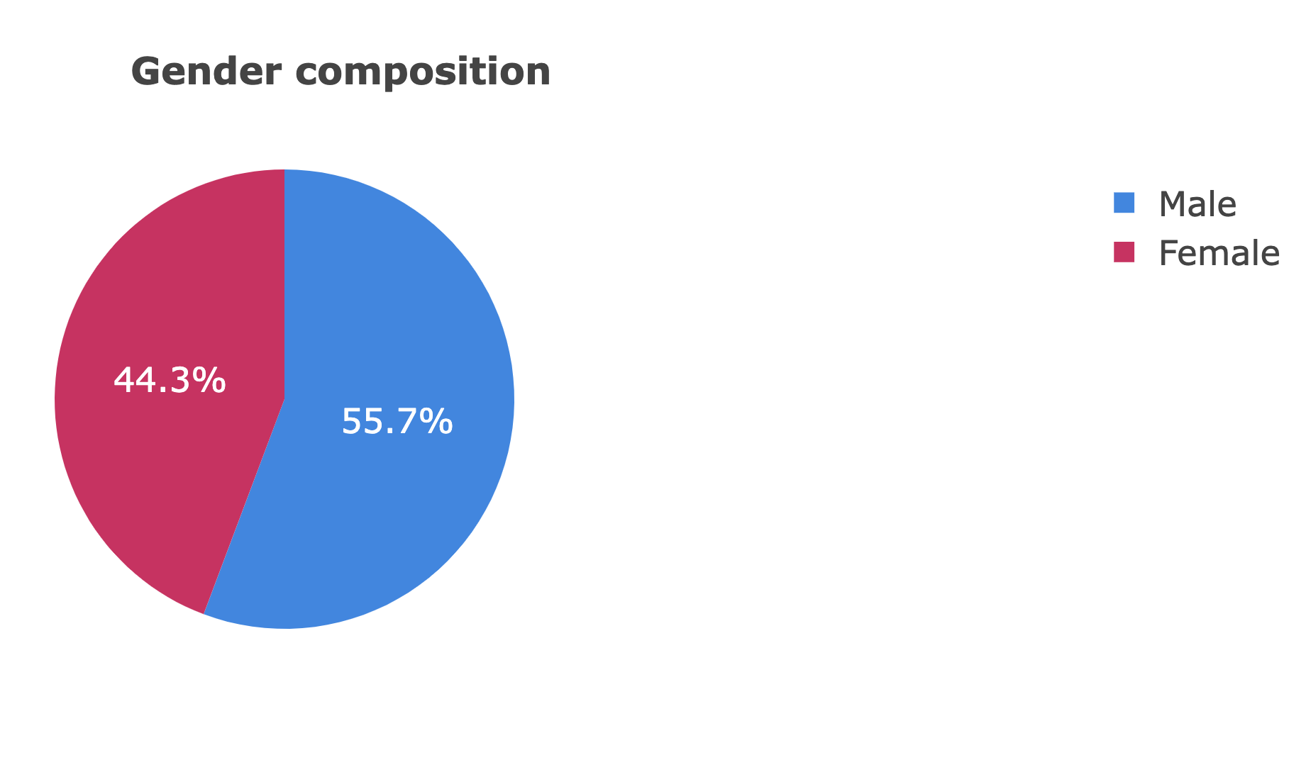
Dataset composition

Slide 4
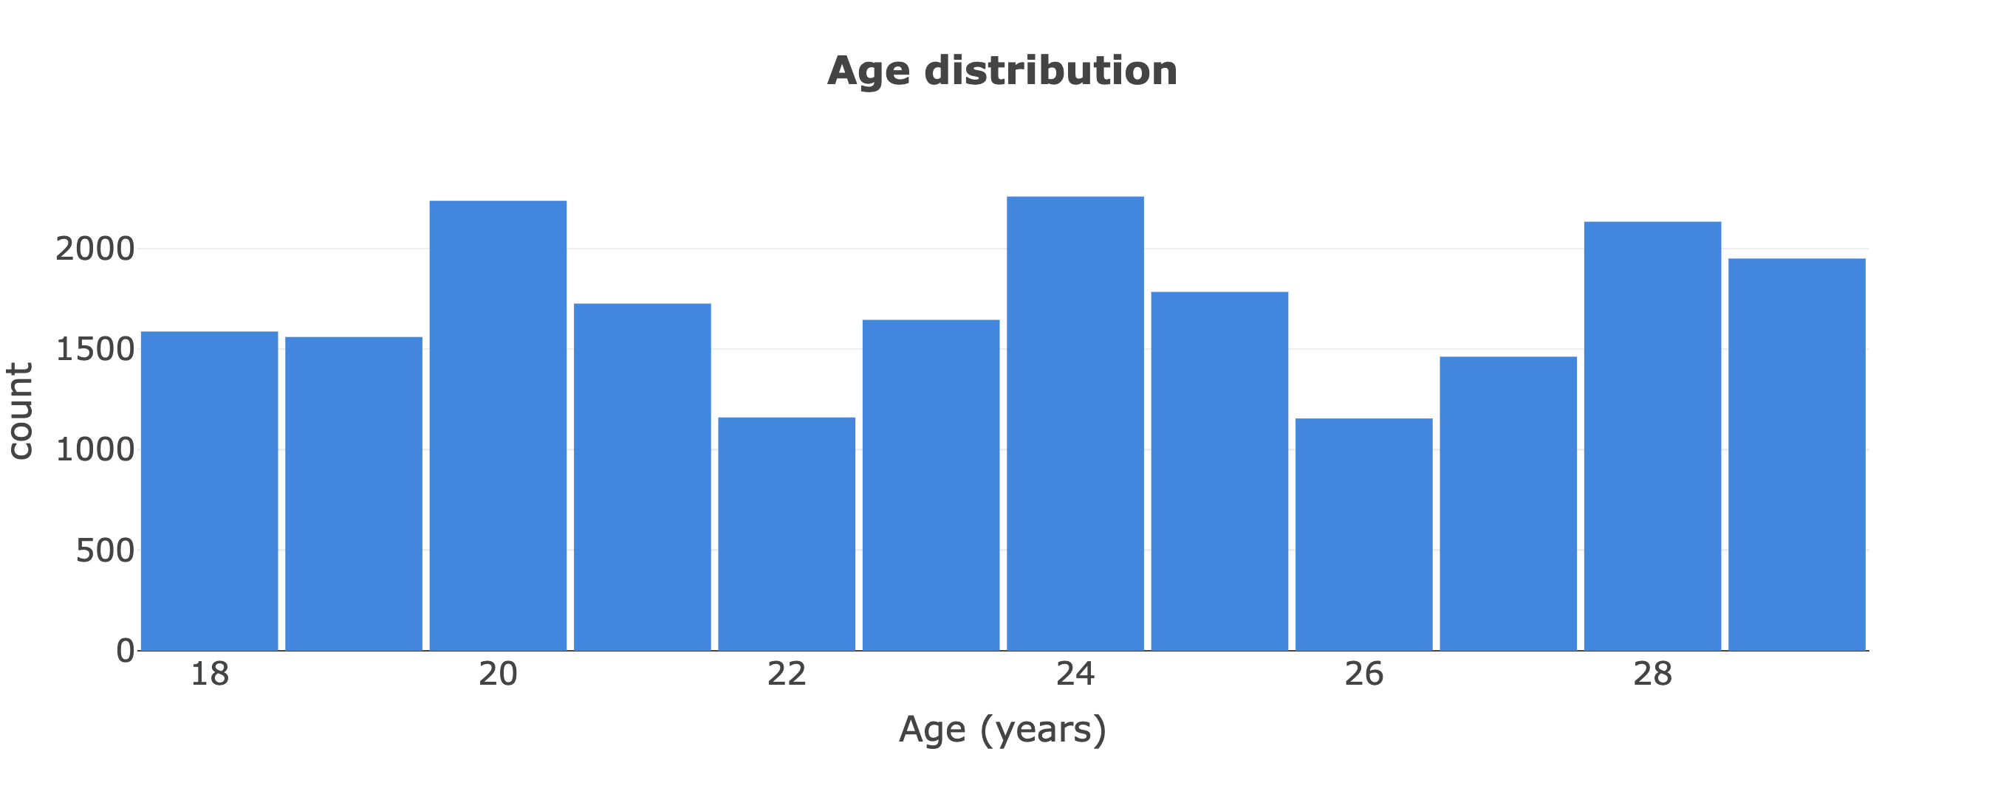
Dataset composition

Slide 5
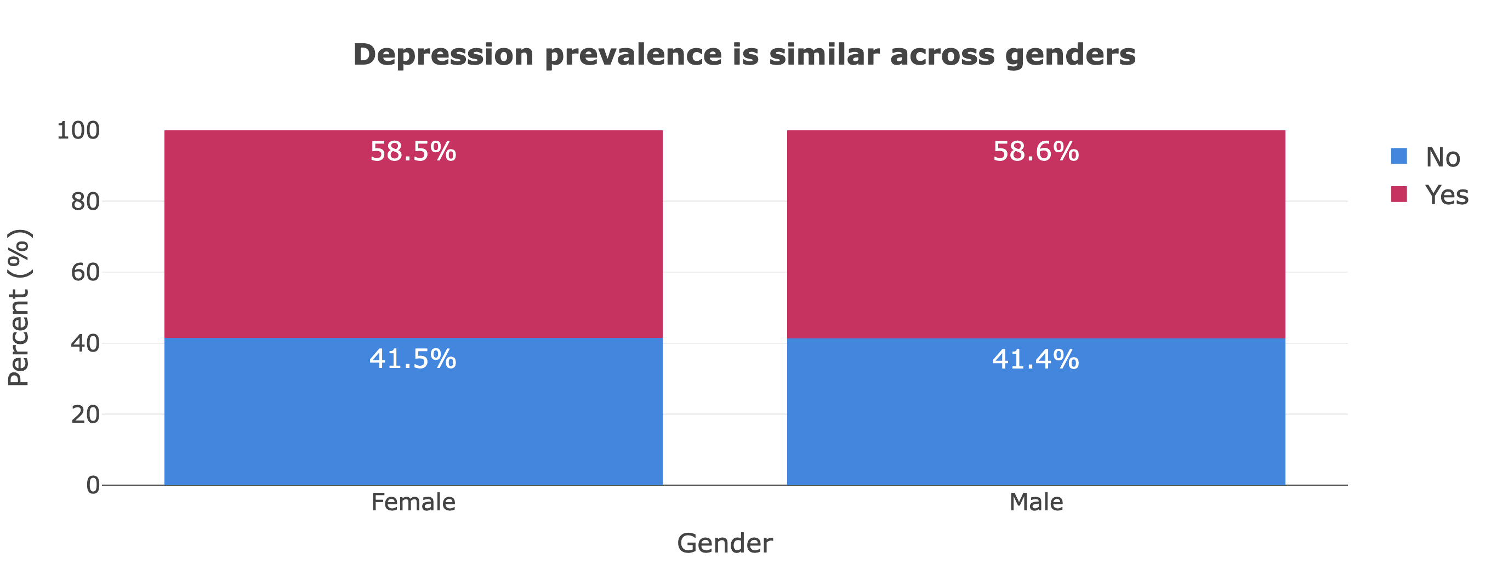
Dataset analysis - 1

Slide 6
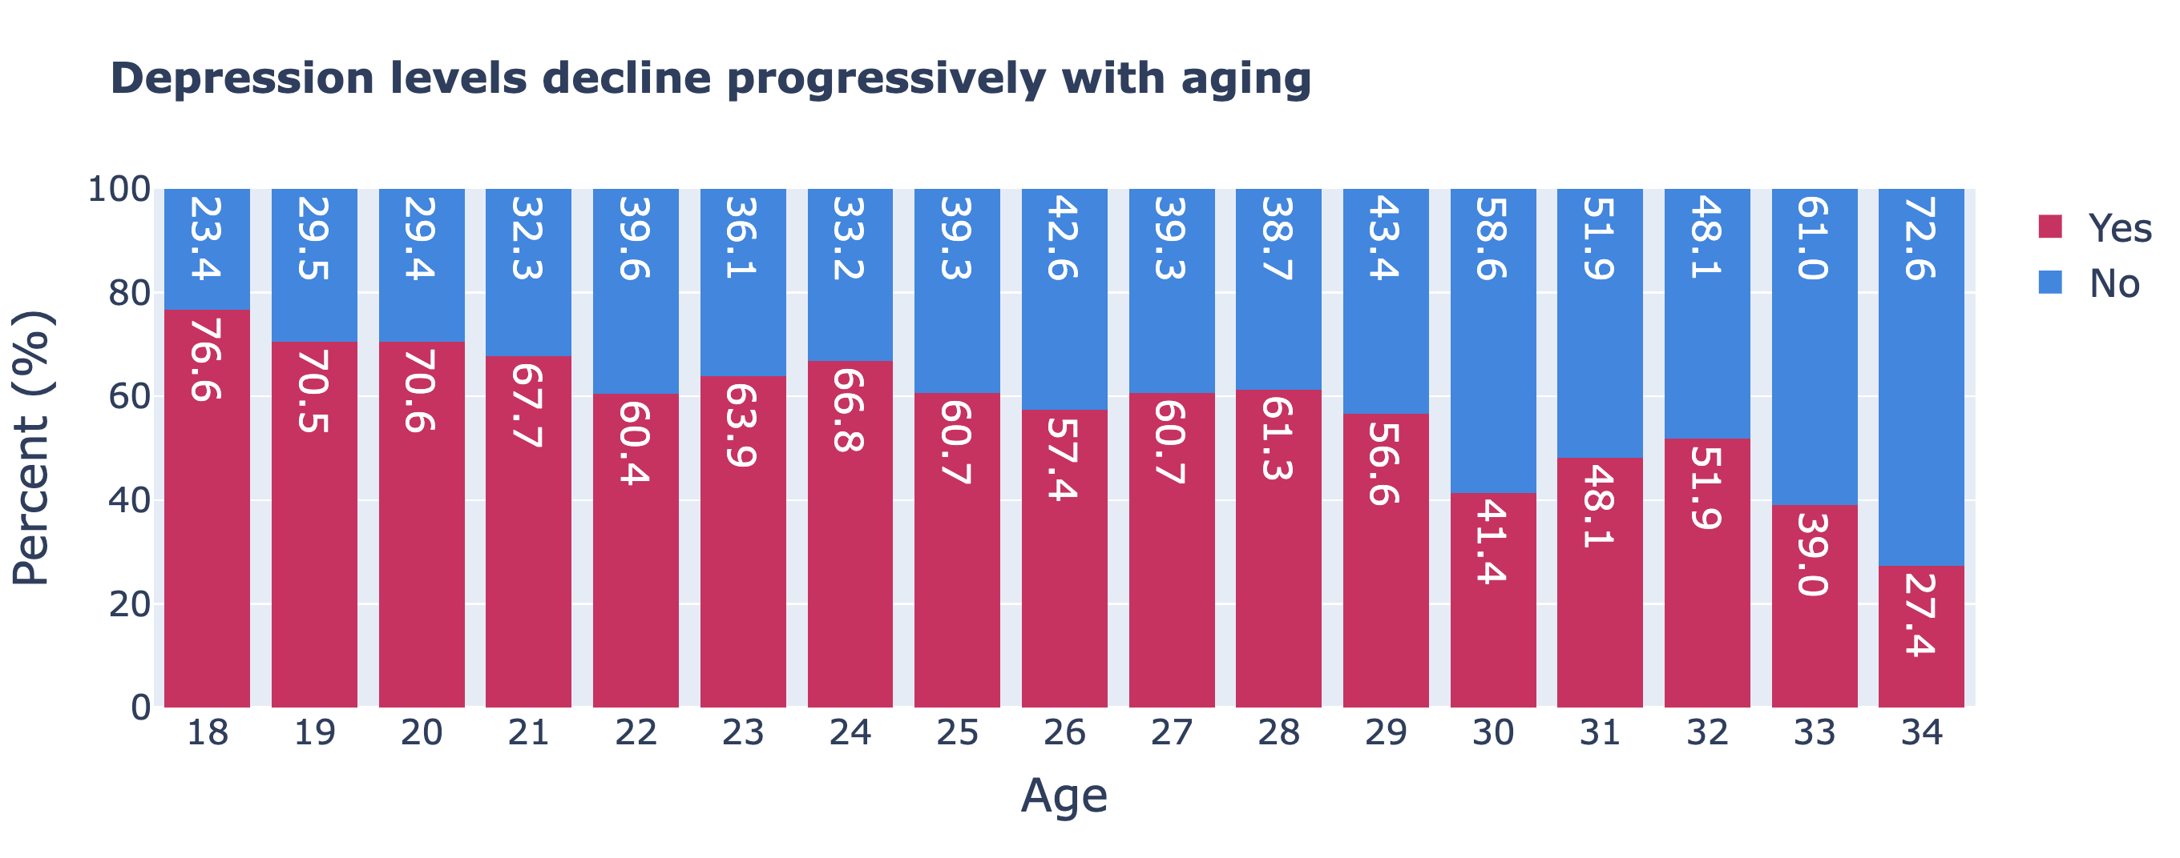
Dataset analysis - 1

Slide 7
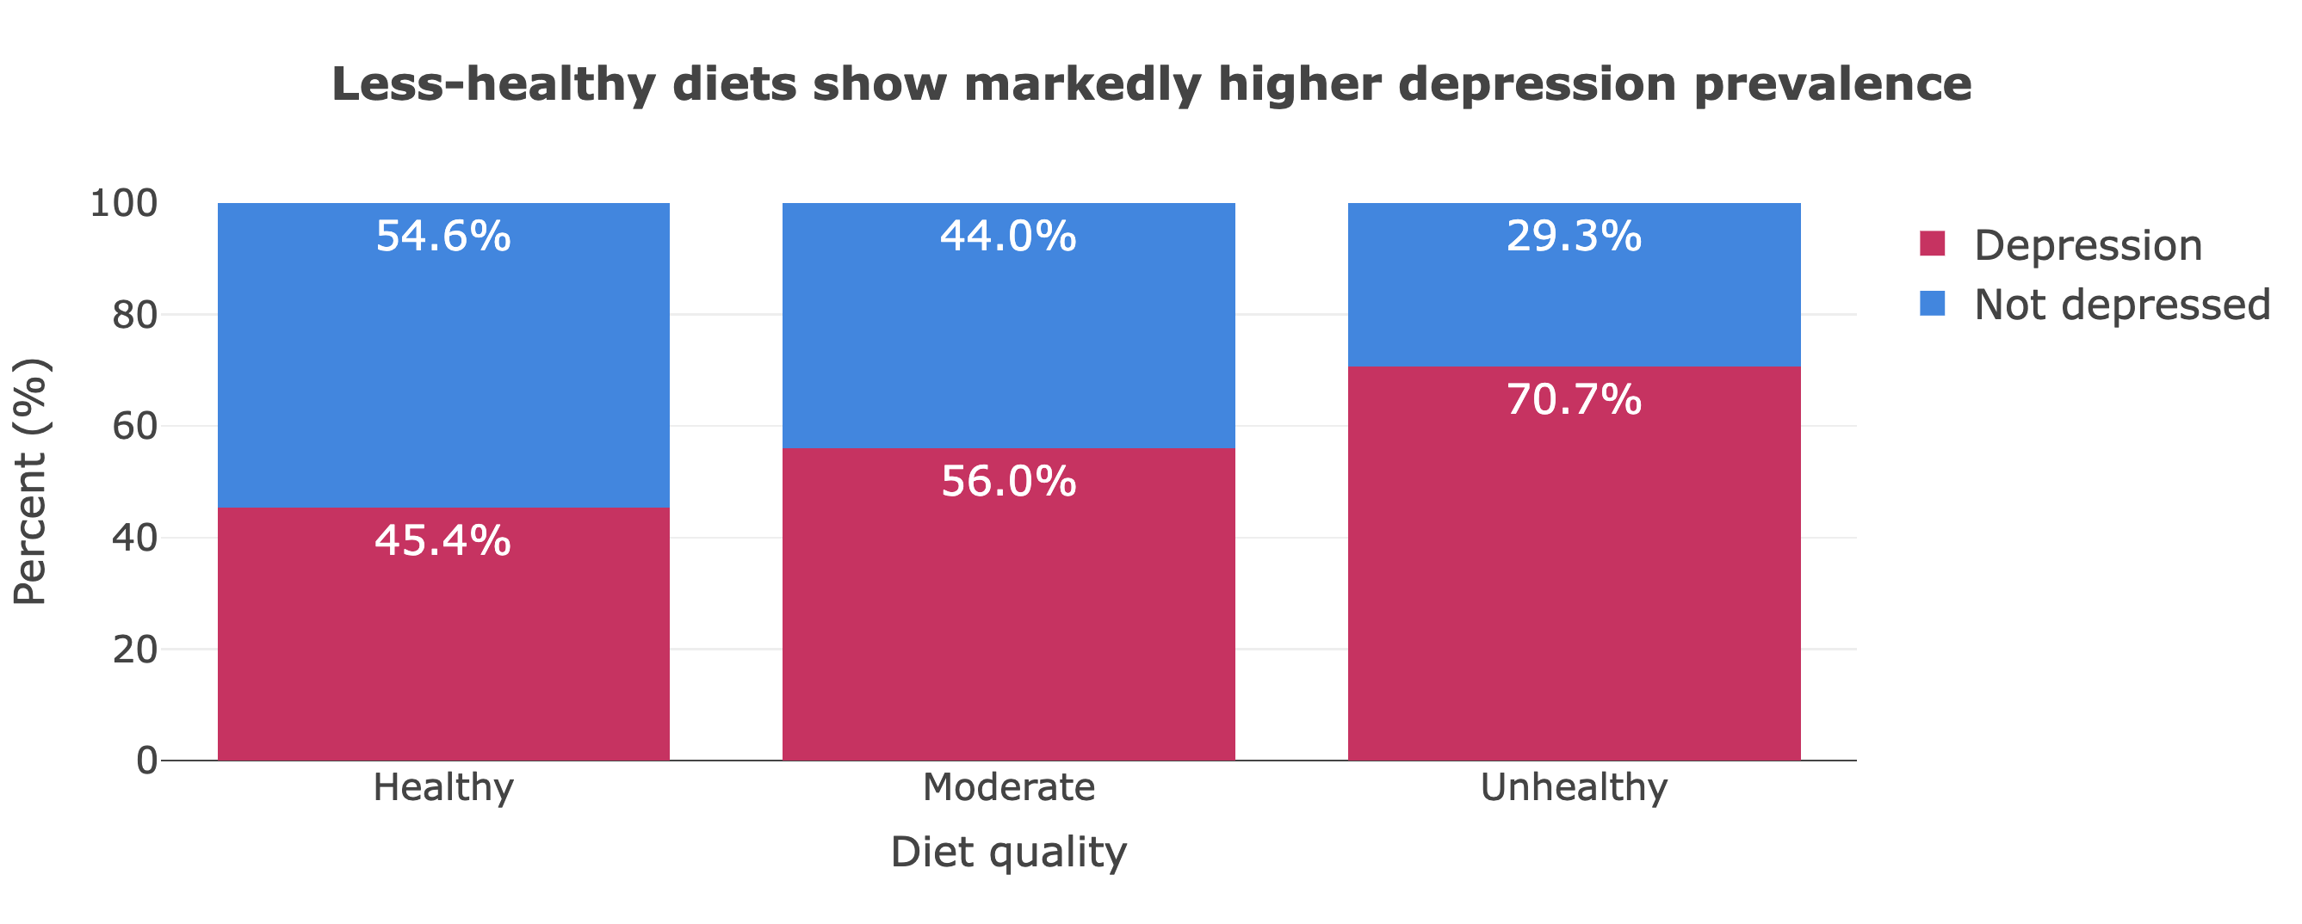
Depression related to diet

Slide 8
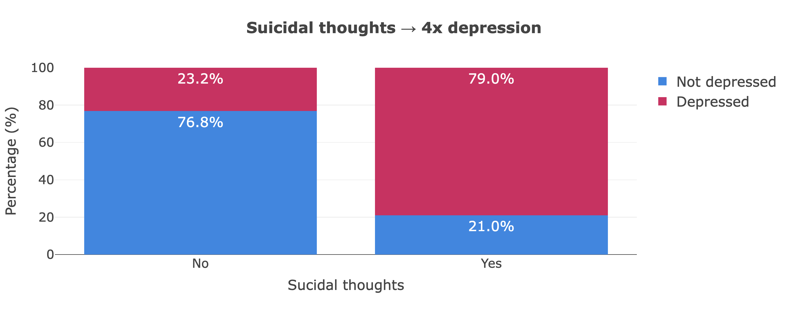
Depression related to suicidal thoughts

Slide 9
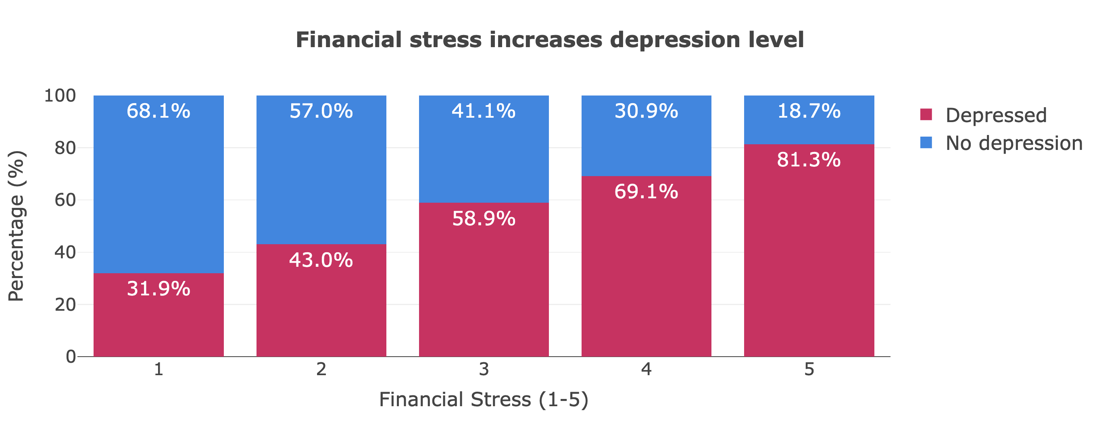
Depression related to financial stress

Slide 10
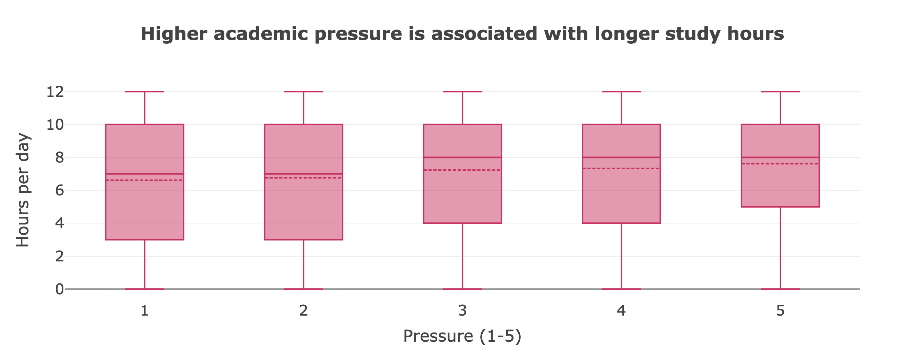
Accademic pressure related to study hours

